Slide 1
Text Based Emotion Detection for Monitoring Criminal’s Behavior and Activities.
GROUP - 8
Md. Main Uddin Hasan, 17301080
Rakeen Ashraf Chowdhury, 16141014
Majwega Jackson, 20266030
Shegufta Mehzabiin, 20166053
Most. Mahjabin, 17101187
Tanzim Ahmed, 20166006
Tamanna Kaiser, 18201137
Rafa Siddiqua, 17301040

Slide 2
Table of content
Introduction
Background / Literature Review
Our plan / Methodology
Potential Challenges
Conclusion
Bibliography

Slide 3
Introduction
Here we mainly concentrate on using Amazon’s Mechanical Turk (MTUrk) a crowdsourcing platform used for collecting data for human language technologies and can be used to pay people small sums of money to complete human intelligence tests an example is Geopall
Many papers have evaluated how effective it is to use Mechanical Turk to create annotated data for natural language processing applications. And the low cost and scalable workforce provided mainly by MTurk makes it easy for speech and text explanation with the ability to create data for human language technologies. It focuses on tasks requiring human intelligence to the field of natural language processing

Slide 4

Related Works
Application of Mechanical Turk (Mturk) to a diverse set of NLP tasks
Includes, creating question-answer sentence pairs.
Evaluating machine translation quality and crowdsourcing translations.
MTurk also used for novel research directions.

Slide 5
Methodology
Text based emotion
Text type characters, such as alphabets words numbers symbol, punctuations , crypto text
System activity
Emotion’s elements :Happy, Sad, Surprise, Shock, fear, anger, disgust

Slide 6
Continued…..
Criminal Emotion
Criminal behave
Criminal activity

Slide 7
Models
Plutchik's model
Contains 8 basic emotions
Wheel of emotions organizes these emotions
Based on the psychological purpose of each
Mechanical Turk (MT)
Minimal expense, exceptionally adaptable technique
Performs assignment that requires human knowledge
Helps the ratio of negative emotions in a Text

Slide 8
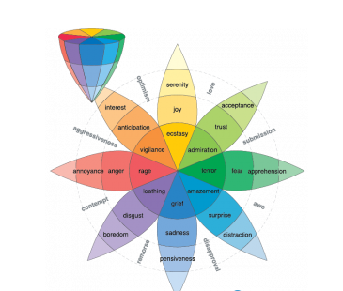
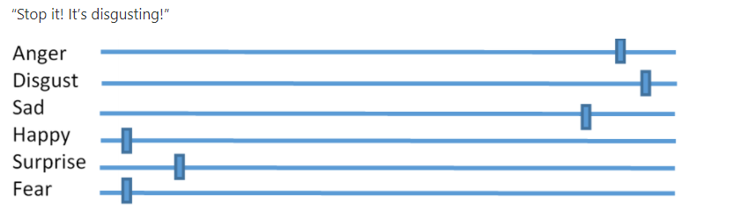
Continued…..
Plutchik's model
Mechanical Turk (MT)

Slide 9
Challenges
Context-dependence of emotions within text
Word-sense disambiguation
Co-reference resolution

Slide 10
References
Taboada, M., Brooke, J., Tofiloski, M., Voll, K., & Stede, M. (2011). Lexicon-based methods for sentiment analysis.Computational Linguistics, 37(2), 267-307. doi:10.1162/COLI_a_00049
Taboada, M., Brooke, J., Tofiloski, M., Voll, K., & Stede, M. (2011). Lexicon-based methods for sentiment analysis.Computational Linguistics, 37(2), 267-307. doi:10.1162/COLI_a_00049
Taboada, M., Brooke, J., Tofiloski, M., Voll, K., & Stede, M. (2011). Lexicon-based methods for sentiment analysis.Computational Linguistics, 37(2), 267-307. doi:10.1162/COLI_a_00049

Slide 11
References
Johnsen, J.-A.K., et al., Differences in Emotional and Pain-Related Language in Tweets About Dentists and Medical Doctors: Text Analysis of Twitter Content. JMIR public health and surveillance, 2019. 5(1): p. e10432.Google Scholar
Callison-Burch, Chris. “Fast, cheap, and creative: evaluating translation quality using Amazon’s Mechanical Turk.” Proceedings of the 2009 Conference on Empirical Methods in Natural Language Processing: Volume 1-Volume 1. Association for Computational Linguistics, 2009.
Callison-Burch, Chris, and Mark Dredze. “Creating speech and language data with Amazon’s Mechanical Turk.” Proceedings of the NAACL HLT 2010 Workshop on Creating Speech and Language Data with Amazon’s Mechanical Turk. Association for Computational Linguistics, 2010.

